Slide 1
Candidate Sites

Slide 2
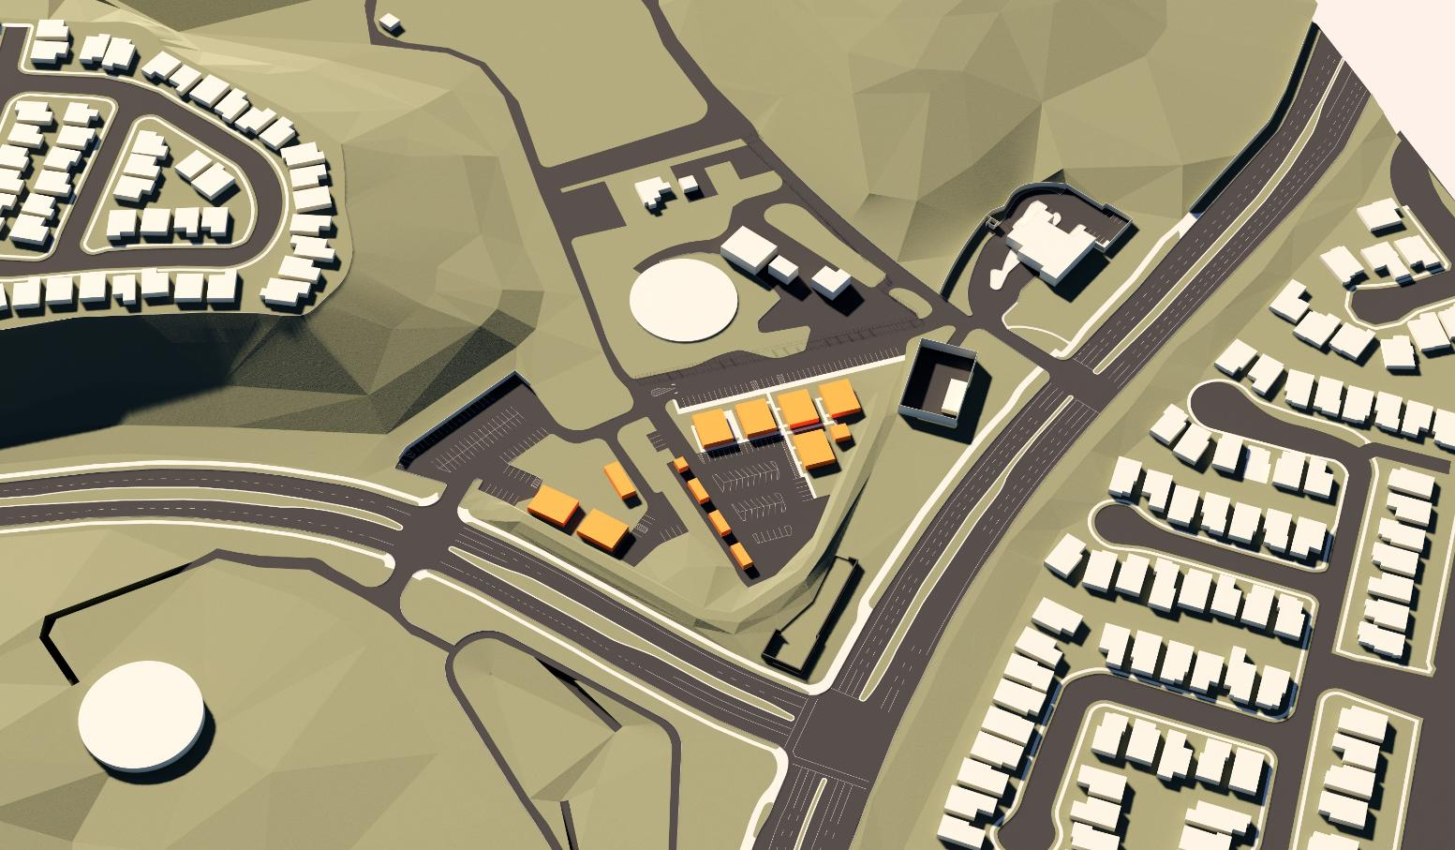
STORAGE FACILITIES
WATER STORAGE FACILITY
IRWD FACILITIES
FIRE STATION
PARKING LOT
ELECTRICAL SUBSTATION
STORAGE FACILITIES
PARKING LOT
ORCHARD HILLS DRIVE
PORTOLA PARKWAY
XXXXXXXX
NEIGHBORHOOD
MONUMENT SIGN
BLUFF
DISTRICT 1 CANDIDATE SITE: IRVINE RANCH CONSERVANCY PROPERTY

Slide 3
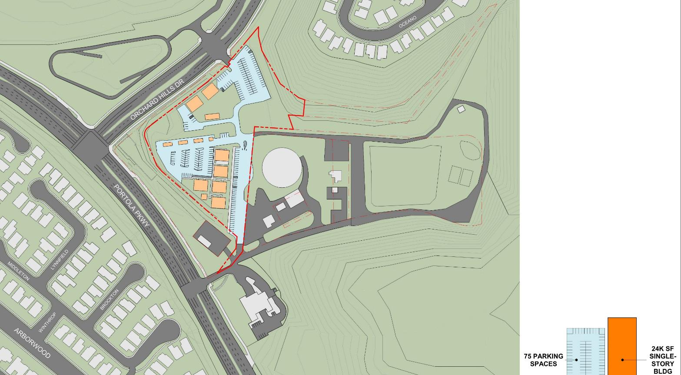


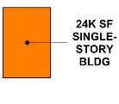
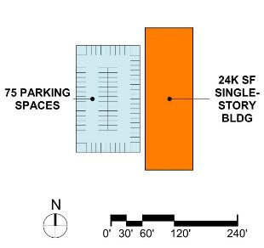
PARKING LOT
STORAGE FACILITIES
LIBRARY FOOTPRINT
@
TWO STORIES
STORAGE FACILITIES
LIBRARY FOOTPRINT
@
SINGLE STORY
PARKING LOT
TWO-STORY
BUILDING
ELECTRICAL
SUBSTATION
PARKING LOT
xxxxxxxxxxxxx
FIRE STATION
WATER STORAGE
FACILITIES
DISTRICT 1 CANDIDATE SITE: IRVINE RANCH CONSERVANCY PROPERTY

Slide 4
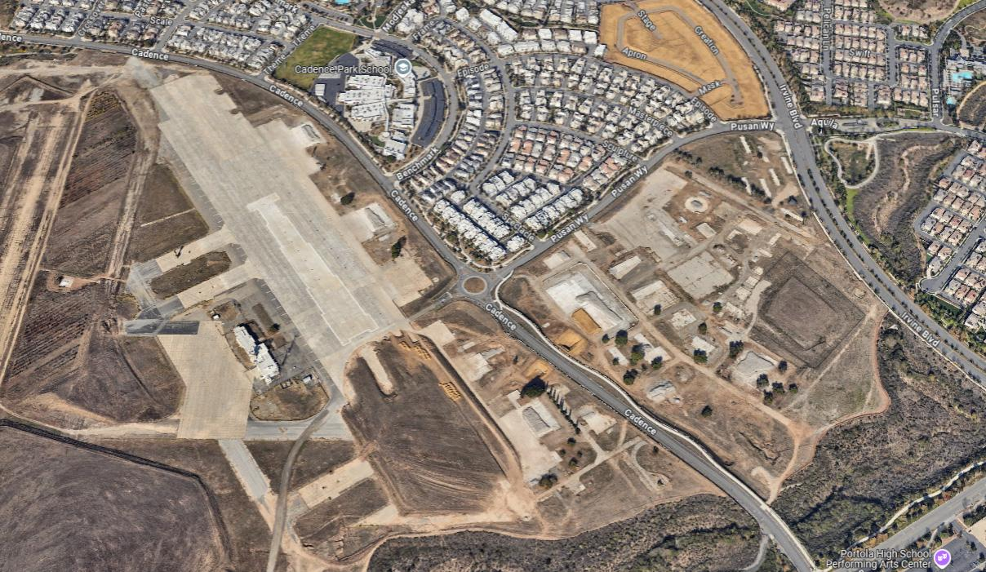
IRVINE BOULEVARD
PUSAN WAY
CADENCE
GREAT PARK
LIBRARY SITE
DISTRICT 2 CANDIDATE SITE: NORTHEAST GREAT PARK

Slide 5
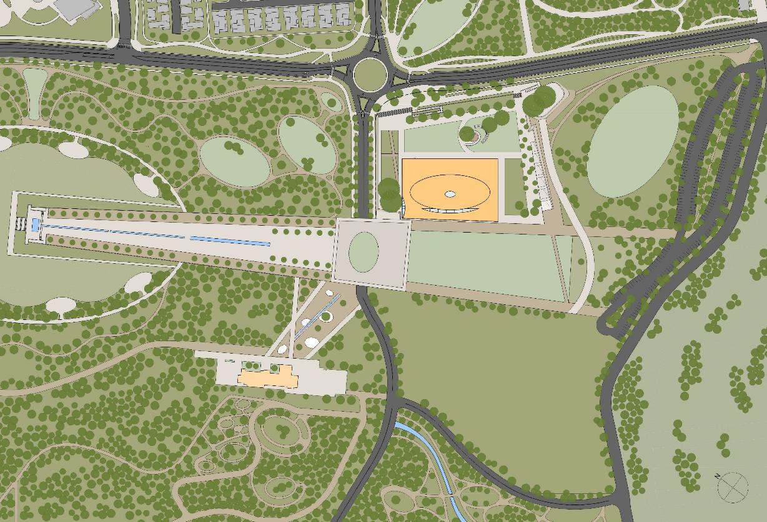
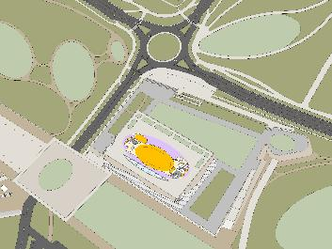
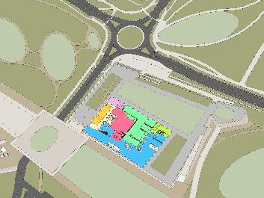
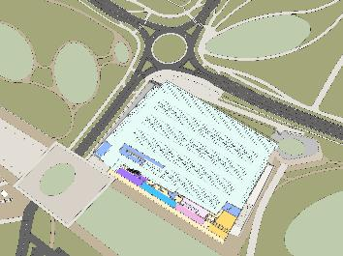
PUSAN
CADENCE
CADENCE
FUTURE VETERANS MEMORIAL
UPPER LEVEL
MAIN LEVEL
IRVINE GREAT PARK REGIONAL LIBRARY
PARKING LEVEL
DISTRICT 2 CANDIDATE SITE: NORTHEAST GREAT PARK
+/- 100-120,000 GSF

Slide 6
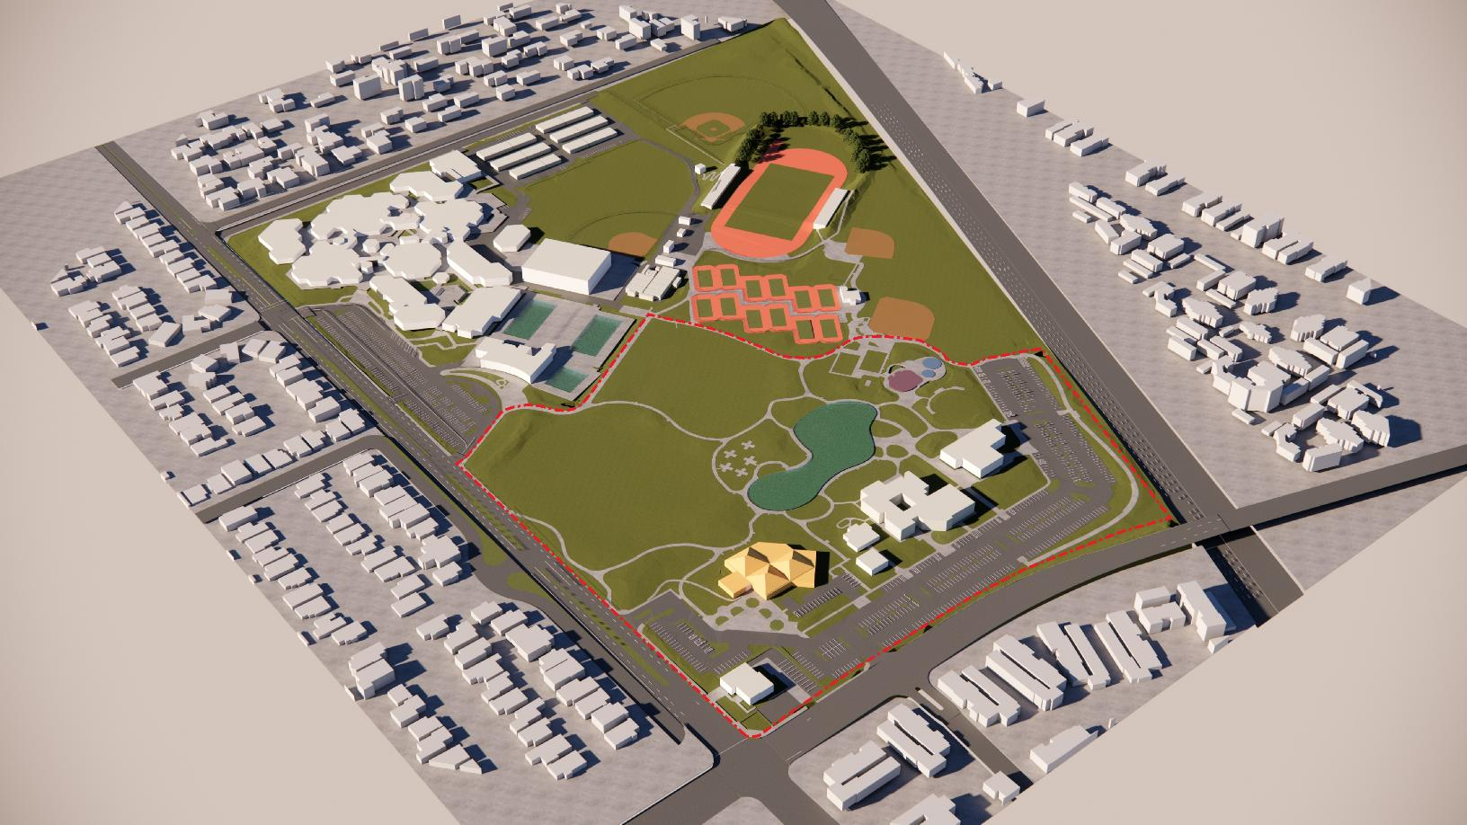
IRVINE HIGH SCHOOL
INTERSTATE 5
PARKING LOTS
COMMUNITY CENTER
WALNUT AVE
FINE ARTS CENTER
HERITAGE PARK LIBRARY
PARKING LOTS
YALE AVE
DISTRICT 3 CANDIDATE SITE: HERITAGE COMMUNITY PARK

Slide 7
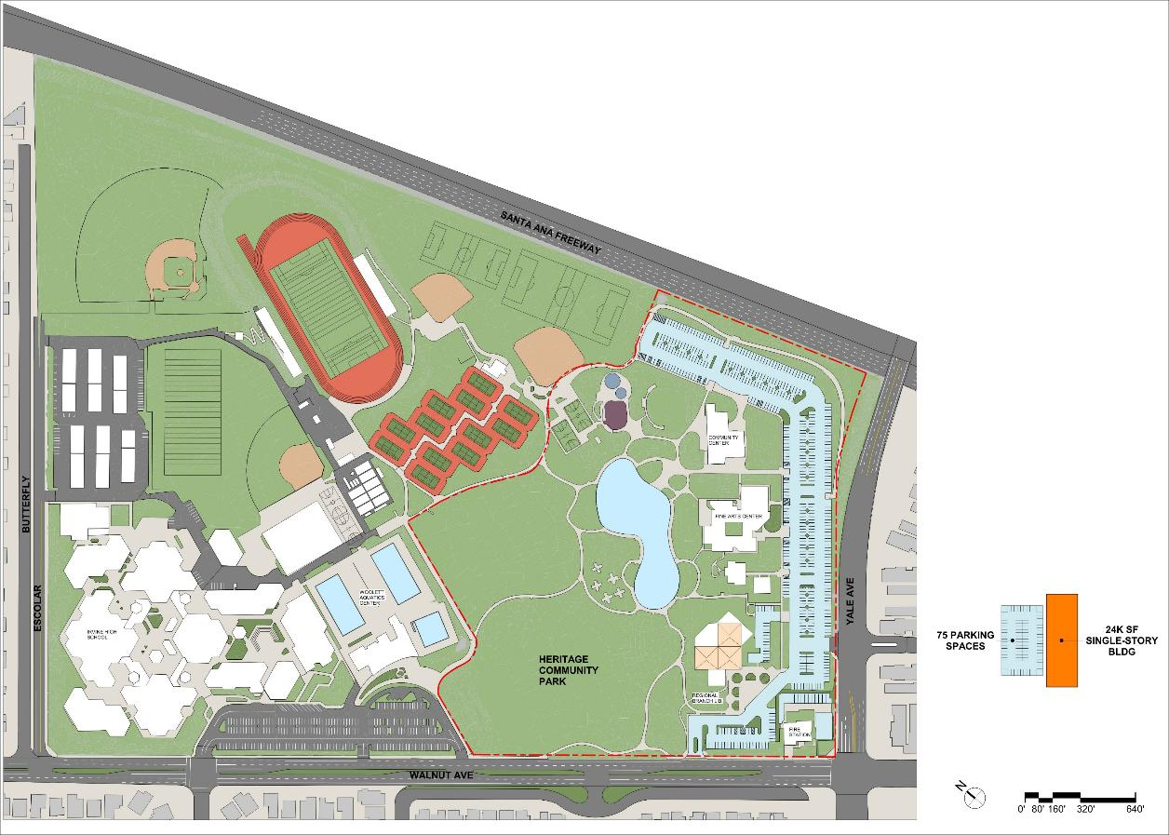
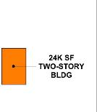
COMMUNITY CENTER
SITE PLAN with 24k building and parking footprint
FINE ARTS CENTER
PARKING LOTS
FIRE STATION
EXISTING HERITAGE PARK LIBRARY
(21,000 SF)
DISTRICT 3 CANDIDATE SITE: HERITAGE COMMUNITY PARK

Slide 8
District 4: A suitable candidate site has not yet been identified

Slide 9
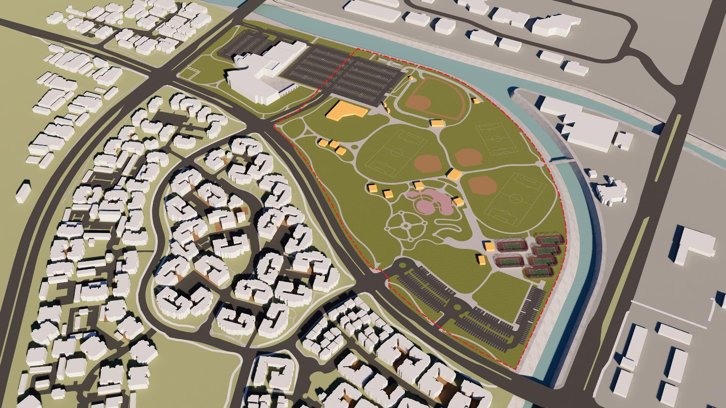
SAN DIEGO CREEK
BALL FIELDS
ALTON PARKWAY
CITY HALL
PARKING LOT
CHILD DEVELOPMENT CENTER
CHILDRENS PLAYGROUND
HARVARD AVENUE
FORMAL GARDEN
TENNIS COURTS
BRANCA PARKWAY
PARKING LOTS
POTENTIAL
BUILDING SITE
DISTRICTS 5 AND 6 CANDIDATE SITE: BILL BARBER MEMORIAL PARK

Slide 10
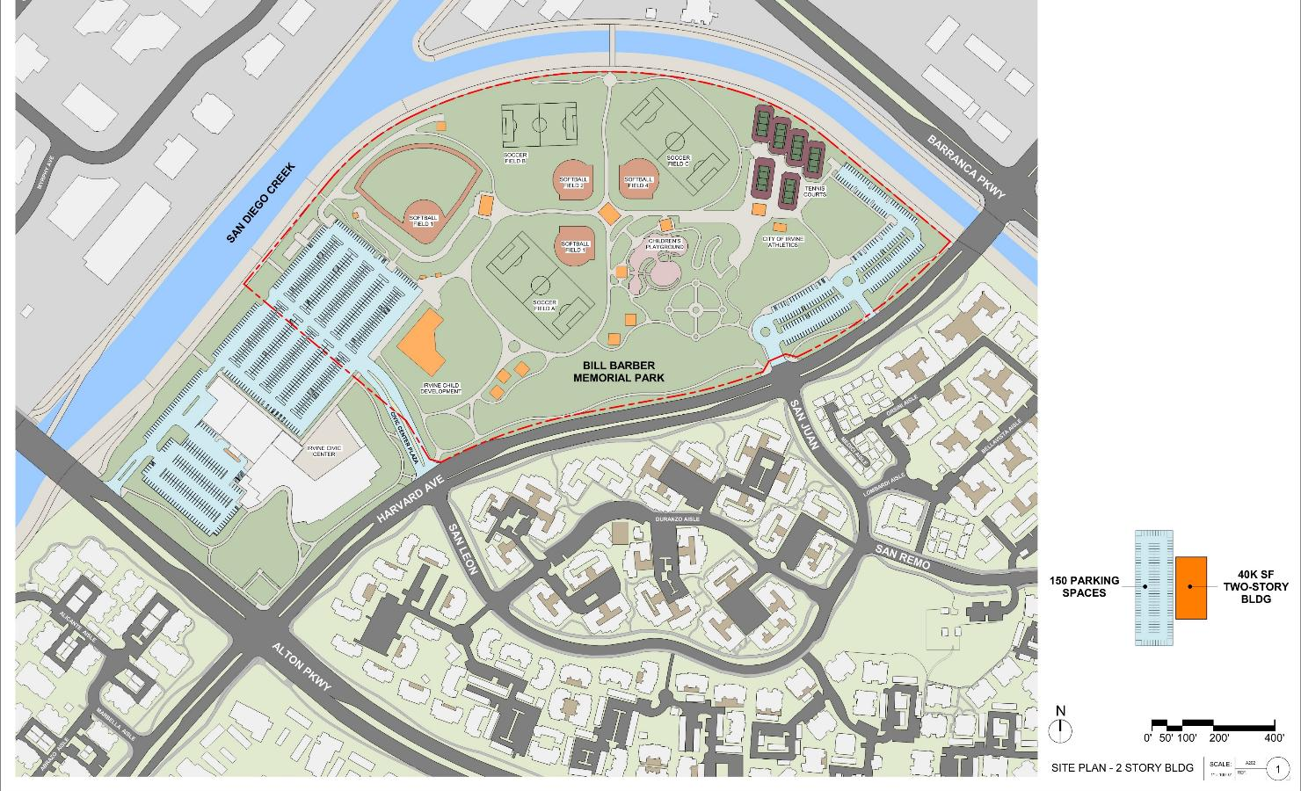
CHILDRENS PLAYGROUND
BALL FIELDS
TENNIS COURTS
PARKING LOT
POTENTIAL BUILDING SITE
CHILDHOOD DEVELOPMENT CENTER
20,000 SF
FOOTPRINT
CITY HALL
xxxxxxxx
FORMAL GARDEN
PARKING LOT
DISTRICTS 5 AND 6 CANDIDATE SITE: BILL BARBER MEMORIAL PARK

Slide 11

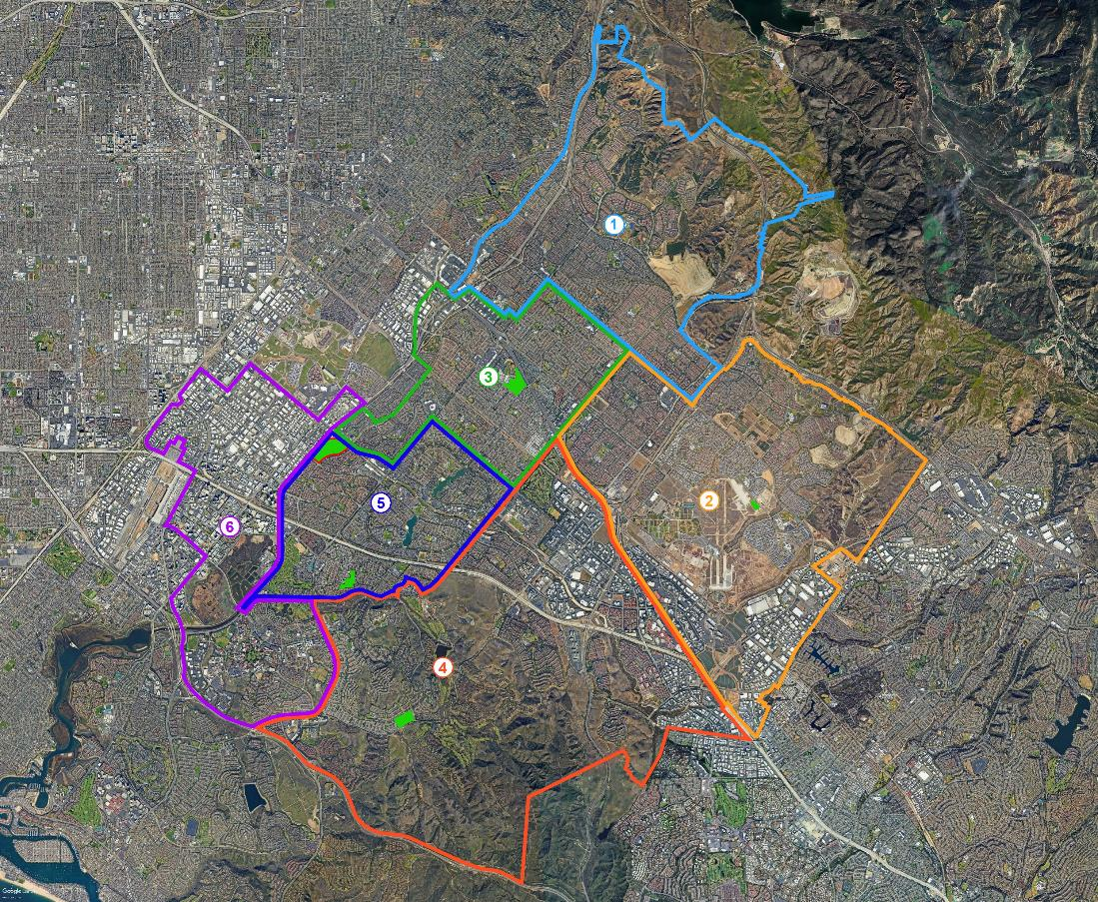
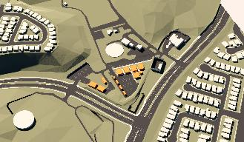
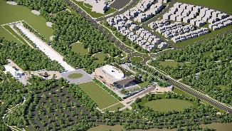
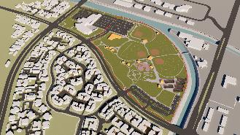
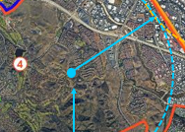
DISTRICT 3 BRANCH LIBRARY
(HERITAGE COMMUNITY PARK)
DISTRICT 1 BRANCH LIBRARY
(ORCHARD HILLS @ PORTOLA PRKWY)
GREAT PARK MAIN LIBRARY
DISTRICT 2
(NORTHEAST SIDE OF GREAT PARK)
WEST REGIONAL LIBRARY
DISTRICTS 5 AND 6
(BILL BARBER MEMORIAL PARK)
DISTRICT 4 BRANCH LIBRARY
(SITE NOT YET DETERMINED)
CANDIDATE SITES WITHIN A COMPREHENSIVE LIBRARY SYSTEM

